Slide 1


Water Consumption and River Levels in Canada: A Comprehensive Study
Group 6
Maroine Ben Ltaief
Hetkumar Patel
Rushanthi Baskaran
Chelsi Nayak

Slide 2
Table of Content
Executive Summary
Background
Analysis
Conclusion & Recommendations
References

Slide 3
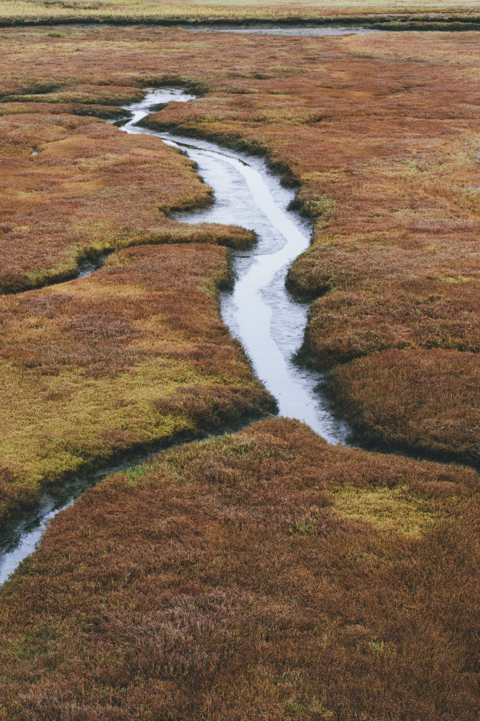
Executive Summary
Water is a critical resource, and its consumption and availability are significant concerns in Canada.
This report provides a comprehensive study of water consumption in Canada, including household, irrigation, and industrial use, as well as river levels across the country.
Our research shows that Canada has one of the highest sources of water in the world; however, any misuse in addition to global climate change are affecting river levels and water quality.
Our analysis highlights the need for efficient practices and technology to reduce water consumption and promote sustainable use of water resources in Canada.
The report concludes with recommendations for policymakers, industries, and households to reduce water consumption, protect river levels, and ensure the long-term availability of water resources in Canada.

Slide 4

Background
Canada is home to many large rivers that support numerous communities, ecosystems, and industries.
However, climate change and human activities, including water consumption, have put significant pressure on river levels and water quality.
In recent years, Canada's population growth, urbanization, and industrialization have increased water demand, leading to concerns about water scarcity in some regions.
According to Statistics Canada [1], the average household in Canada consumes about 215 liters of water per day, and irrigation and industrial use also contribute significantly to the overall water consumption in Canada.

Slide 5

Analysis
The analysis of our study shows that household water use accounts for 51% of the total water consumption in Canada. Inefficient fixtures, leaky pipes, and wasteful practices accounted for 18% of the volume of water produced in 2019 [1] and contribute to the high rate of water consumption.
Canadian farms used approximately 40% less water to irrigate their harvests in 2020 compared to the previous two years, owing primarily to more rainy weather in Canada [2].
Our research also shows that overall, the amount of water in 2019 was higher-than-average at 19% of locations, 74% of the sites are typical, and lower-than-average at 7% of sites [3].
Changing precipitation patterns, melting glaciers, and reduced snowpacks have led to decreased river flows and lower water levels in some regions.
Despite having extensive freshwater supplies, Canadians are among the world's biggest water consumers per individual. Canada withdraws approximately 44.7 billion cubic meters of freshwater per year, 64% of which is used for thermal electricity production.
In Canada, nearly two out of every three liters of freshwater extracted is used for industries and electricity production [4]. Industrial water use, on the other hand, is extremely effective, and water is typically recycled.

Slide 6
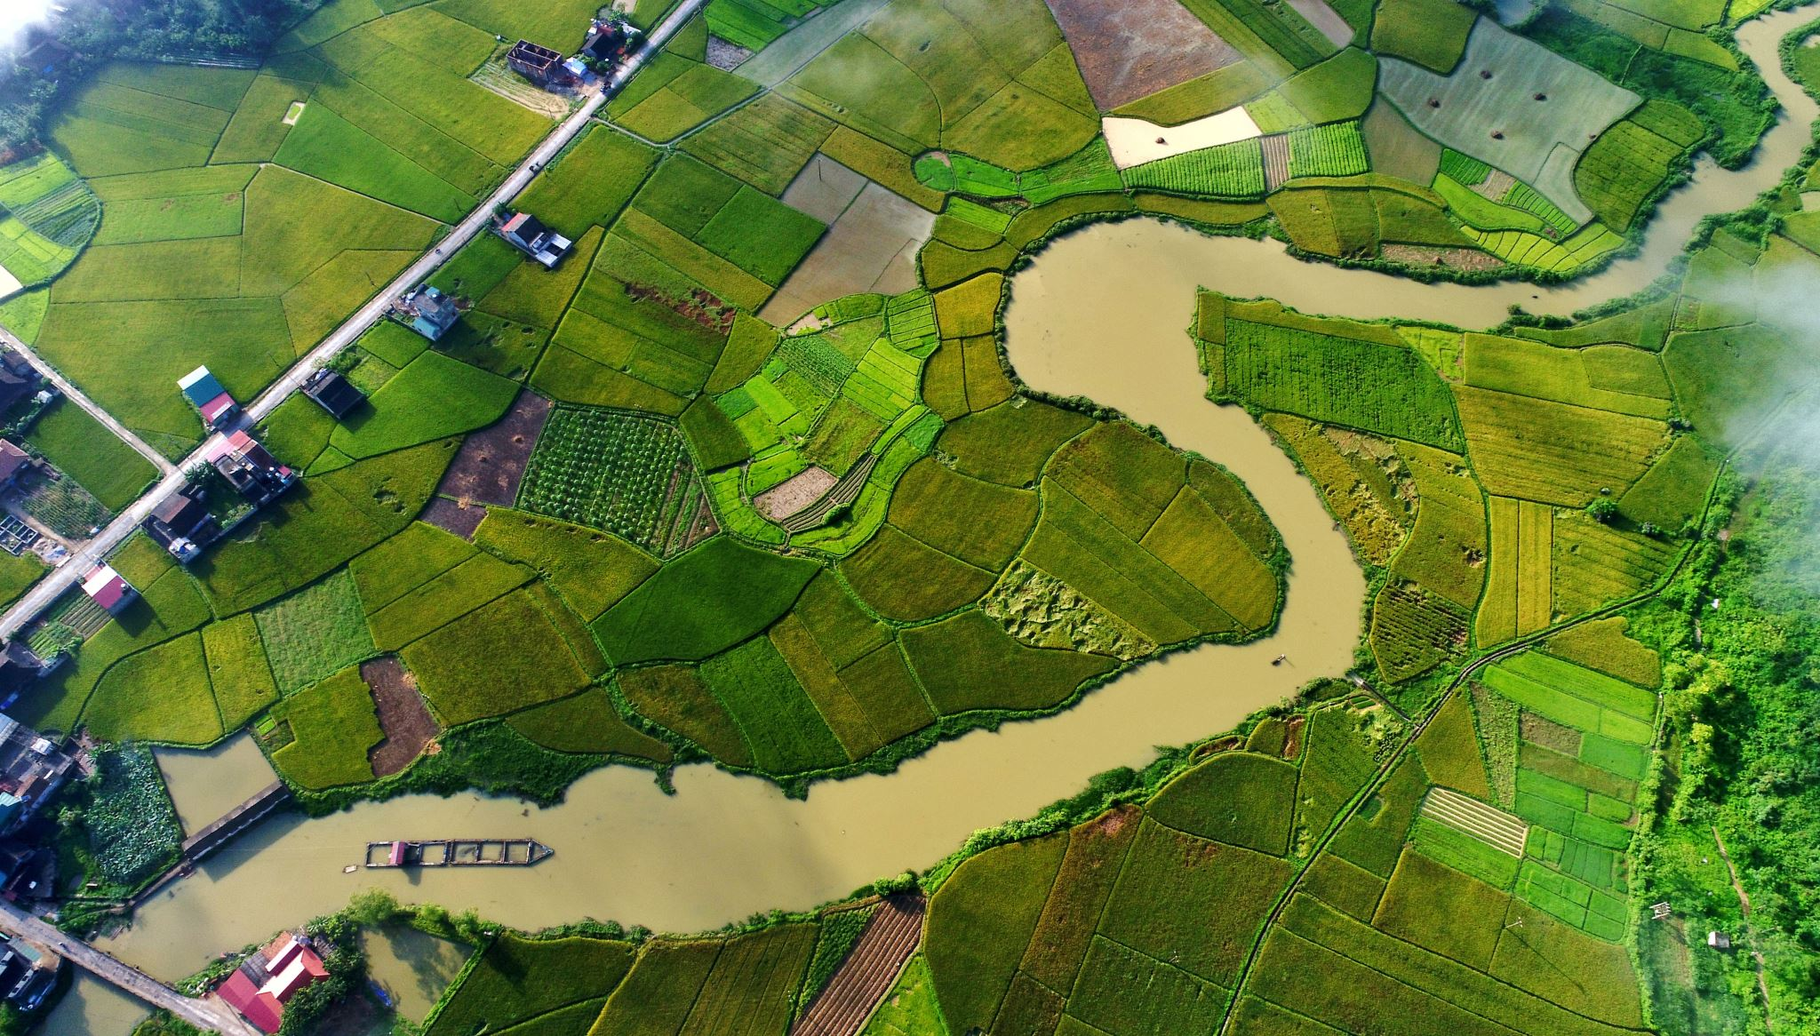
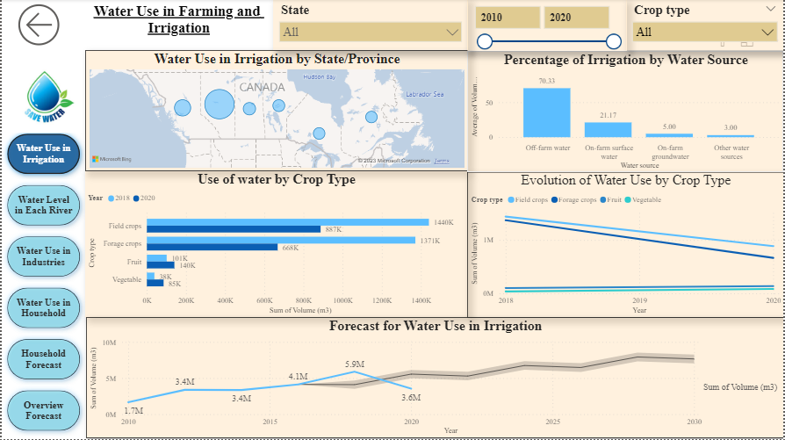
Water Use in Irrigation

Slide 7
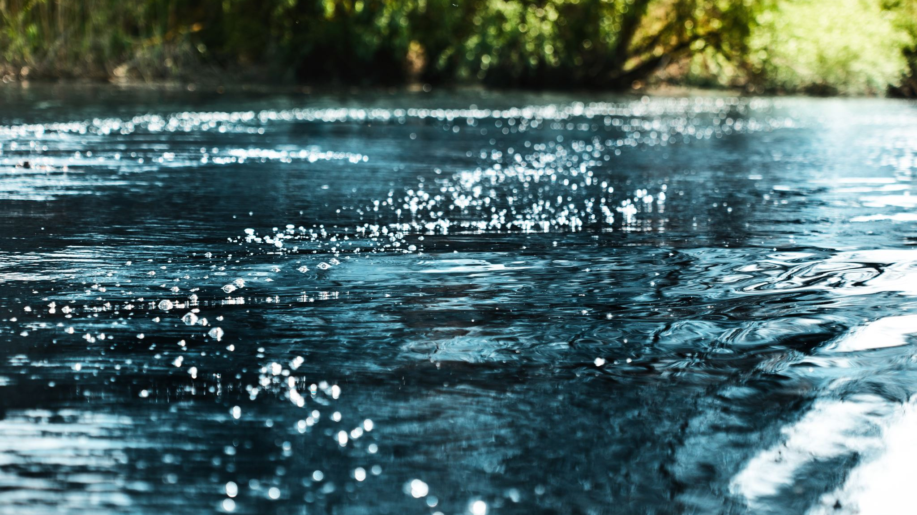
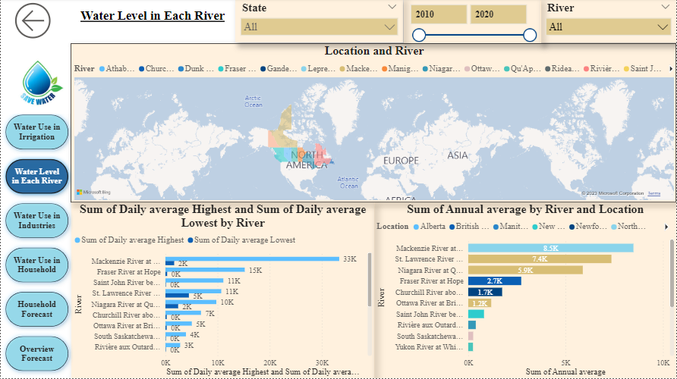
Water Level in Each River (By Province)

Slide 8
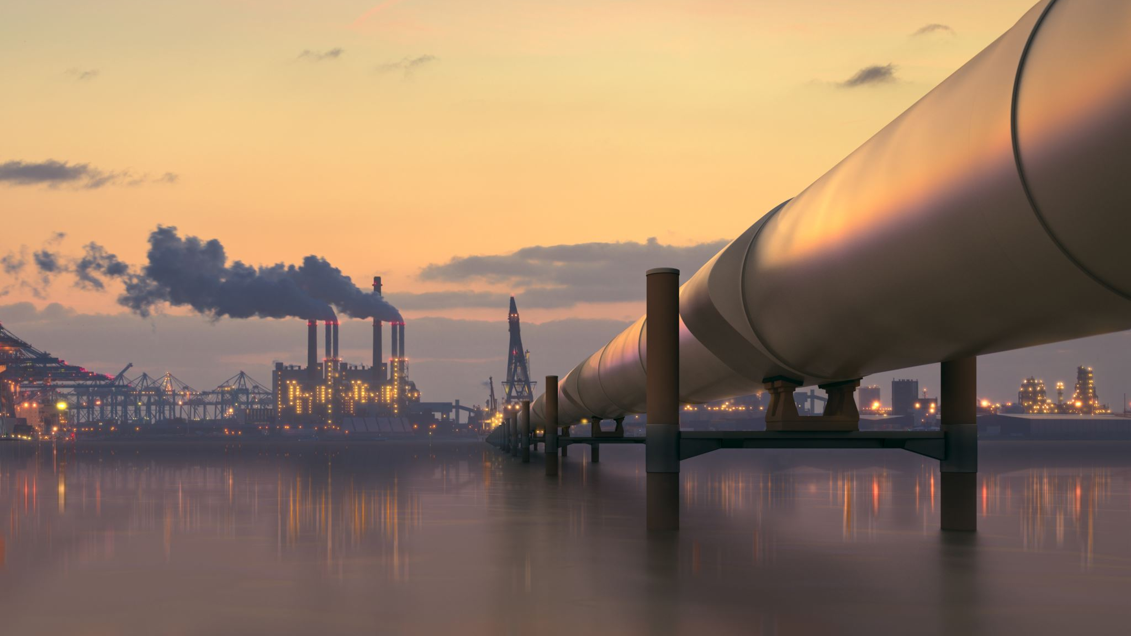
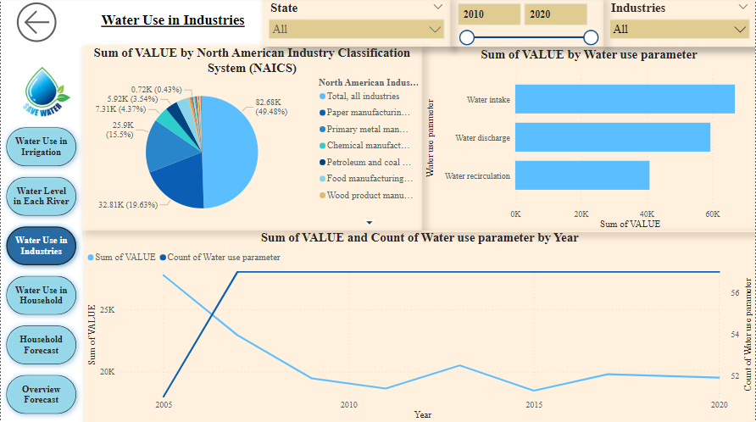
Water Use by Industries

Slide 9
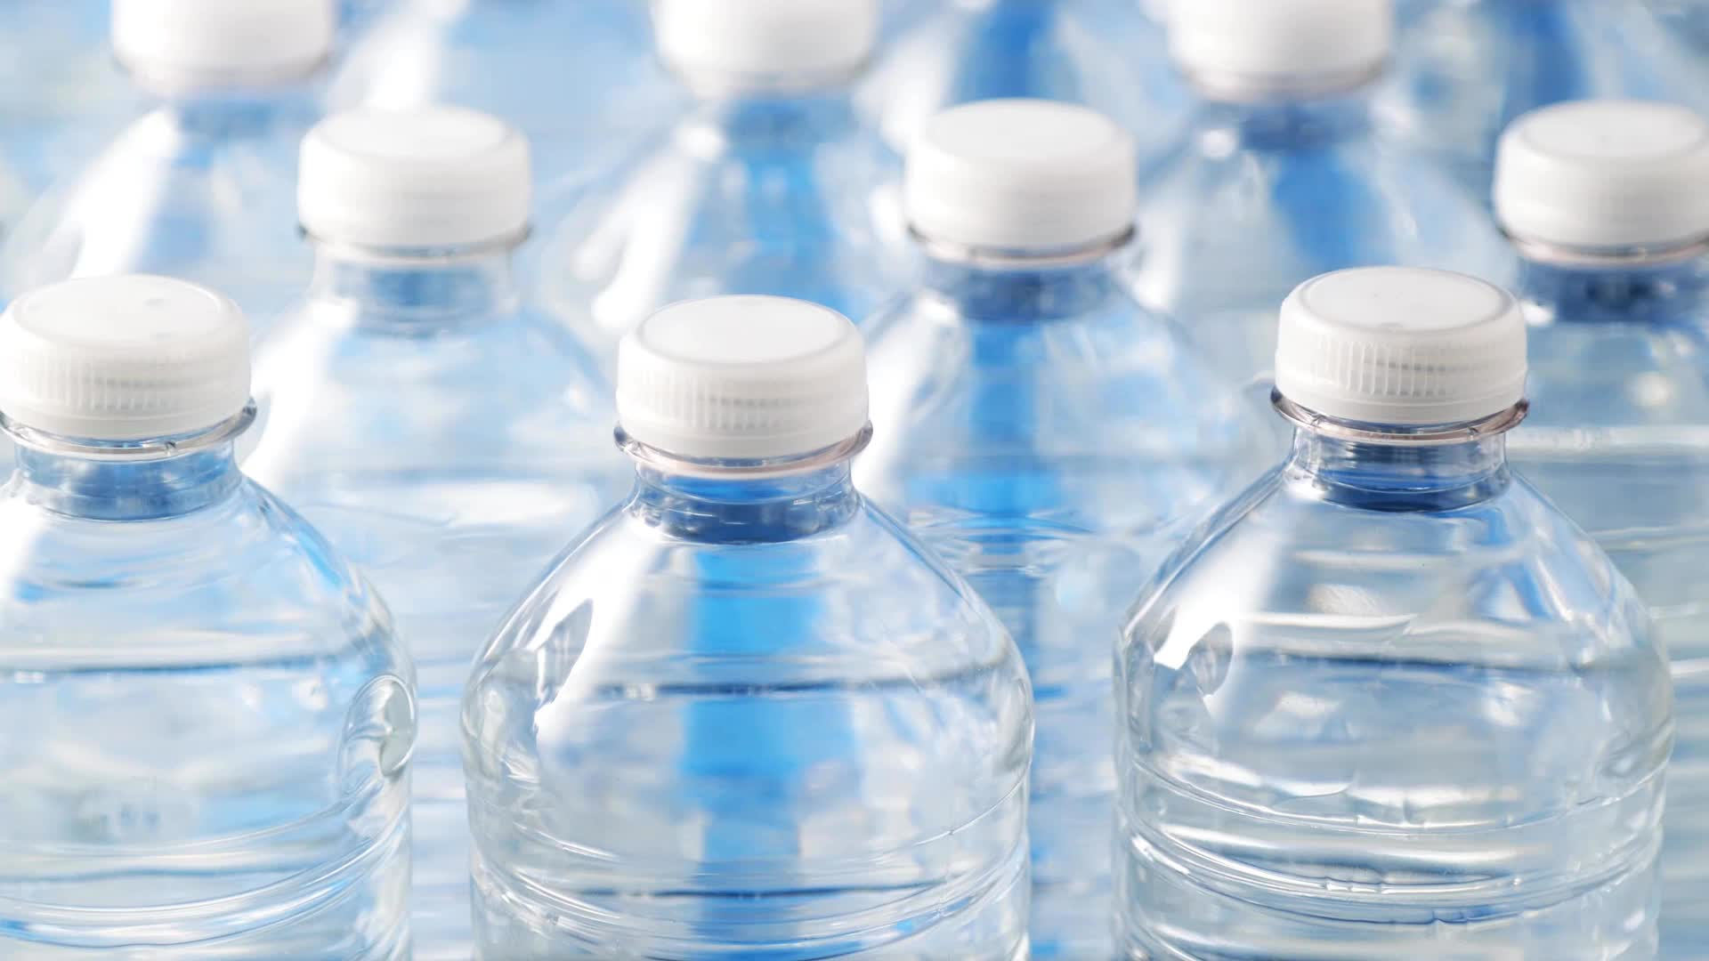
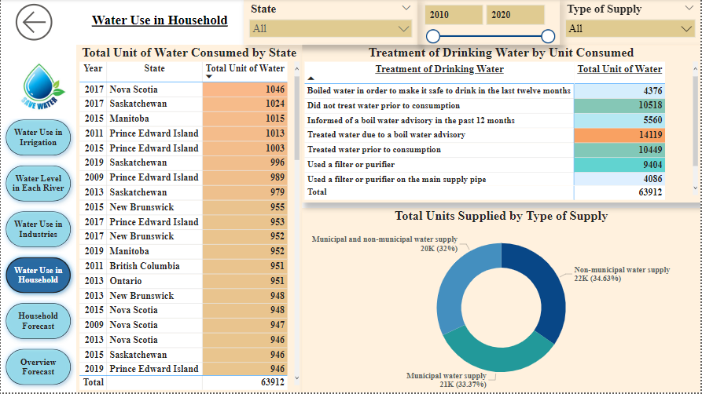
Water Use in Household

Slide 10
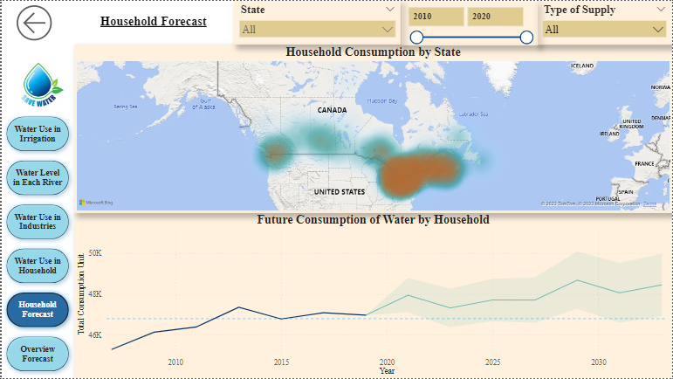
Household Forecast

Slide 11
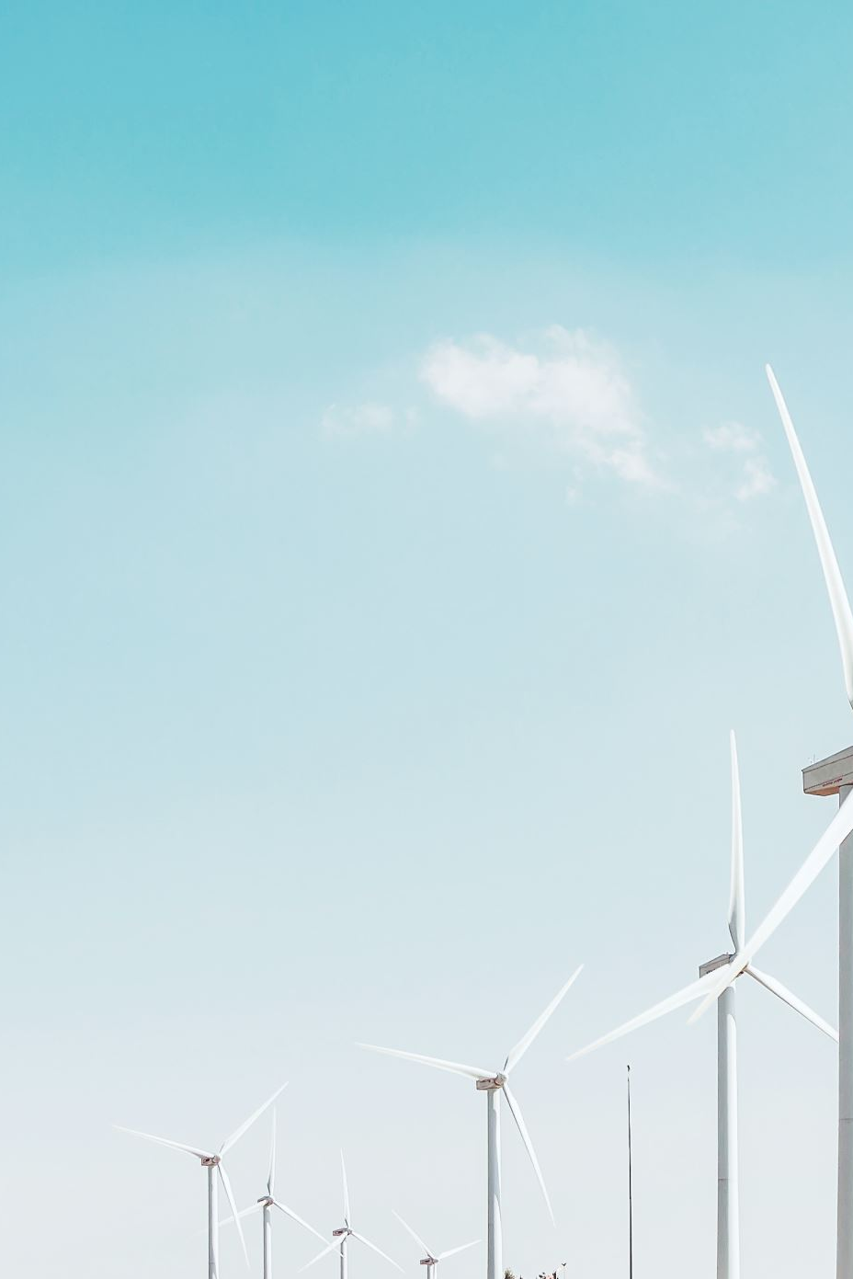
Recommendations
The study concludes that despite that Canada is in a safe zone in terms of water resources, reducing water consumption through efficient practices and technology is crucial to ensure the sustainable use of water resources in Canada and protect river levels
The following are some of the recommendations for policymakers, industries, and households:
Promote water-efficient practices and technologies in households and industries to reduce water consumption.
Encourage the use of drought-tolerant crops and advanced irrigation systems to reduce water use in the agricultural sector.
Develop water reuse and recycling programs to reduce water use in industrial processes.
Increase public awareness about water conservation and encourage the adoption of water-efficient practices.
Strengthen water management policies and regulations to ensure the sustainable use of water resources and protect river levels.
Invest in research and technology to better monitor and manage water resources, including river levels and water quality.

Slide 12
Conclusion
In conclusion, during the last decade, Canadians follow a fairly stable water consumption pattern with a small trend to increase in the coming years. The recommendations provided in this report can serve as a guide for policymakers, industries, and households to reduce water consumption, protect river levels, and ensure the long-term availability of water resources in Canada.

Slide 13
Reference
[1] Statistics Canada, "Survey of Drinking Water Plants," 2019. [Online]. Available: https://www150.statcan.gc.ca/n1/daily-quotidien/210817/dq210817c-eng.htm.
[2] Statistics Canada, "Agricultural Water Survey," Government of Canada, 2020. [Online]. Available: https://www150.statcan.gc.ca/n1/daily-quotidien/211213/dq211213d-eng.htm.
[3] Government of Canada, "Water Quantity in Canada," 2019. [Online]. Available: https://www.canada.ca/en/environment-climate-change/services/environmental-indicators/water-quantity-canadian-rivers.html.
[4] Danamark, "Water Use in Canada," 2015. [Online]. Available: https://danamark.com/resources/water-use-canada/.

